Slide 1
AFF8080 cDOT Architecture
Storage Design and Engineering An Introduction to AFF8080 and cDOT 8.3.2P7 Architecture at TR
Ian Daniel
Craig Goettig
26-April-2016

Slide 2
Agenda
INTRODUCTION
AFF8080 System Configuration
AFF8080 I/O
AFF8080 Primary Design
AFF8080 Capacity
AFF8080 Performance
Changes In cDOT 8.3.2P7
Network Configuration
Root-Data Partitioning
Management Infrastructure
Data Protection

Slide 3
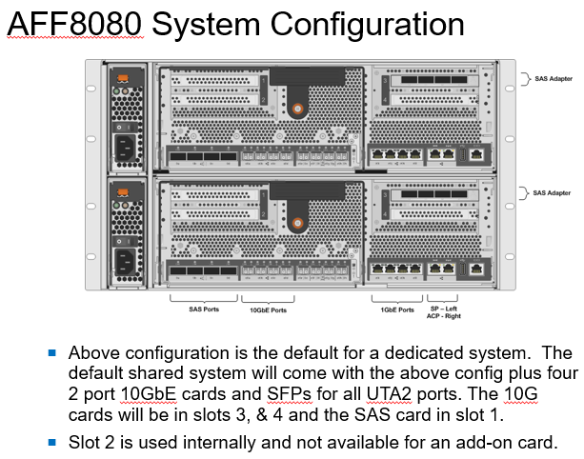
AFF8080 System Configuration

Slide 4
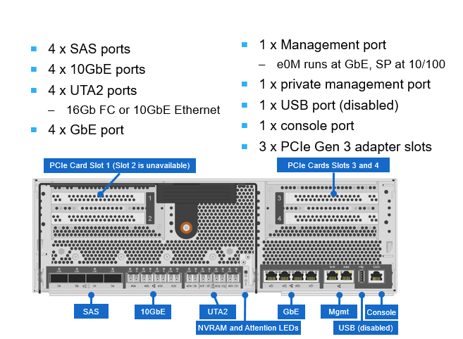
AFF8080 Controller I/O

Slide 5
AFF8080 Primary Design (Dedicated or HT)
AFF8080 HA Pair, (single 6u chassis)
DS2246 shelves of 800GB SSD drives
1 or 2 shelf dedicated configuration
DS2246 shelves of 3.8TB SSD drives
1 shelf dedicated configuration
2 shelf shared configuration (Standard High Tier configuration)
10GbE connectivity for data access
4 x 10GbE Ports used for LACP
All shared filers connect to CoLo by default along with their primary networks.
1GbE connectivity for management

Slide 6
AFF8080 Capacity
Capacity Dedicated Configurations
5.5TBs usable per controller (1/2 shelf of 800GB SSDs per controller)
13.4TBs usable per controller (1 shelf of 800GB SSDs per controller)
28TBs usable per controller (1/2 shelf of 3.8TB SSDs per controller)
Capacity for Shared Configurations
65.6TBs usable per controller (1 shelf of 3.8TB SSDs per controller)

Slide 7
AFF8080 Performance
Peak throughput at 32k sequential 50/50 read/write mix:
2.02 GB/sec per controller
63,000 IOPs per controller
Peak IOPs at 4k random 50/50 read/write mix:
102,000 IOPs per controller
408 MB/sec per controller
Performance profile maximums (2 shelf 3.8TB config)
31 MB/sec per TB
1555 IOPs per TB

Slide 8
Changes In Clustered Data Ontap 8.3.x (cDOT)
Milestone release – No more 7-Mode Major Releases from this point onwards. 7-Mode continues to be patched and remains at 8.2.x.
Highlights Of New Features/Changes
Ability to manage CIFS shares using MMC.
Support for showmount when enabled on vserver.
QoS enhancements - Workload based QoS/Policies in MB/Sec and IOPS. Better statistics.
Compression enhancements (enabled by default on AFF)
FLI support for ISCSI LUNs (Foreign LUN Import) – This is on hold, however, until ISCSI is tested in SI due to MSSQL requirements.
IP Spaces and Broadcast Domains (More later)
Deleted volume recovery
Root-Data Partitioning is used on AFF8080 and potentially can also be used on other entry level systems.
Requires OCUM 7.1.x and OPM 7.1.x
Requires WFA 4.x

Slide 9
Changes In Clustered Data Ontap 8.3.x (cDOT) … Continued
6TB Disk Support (Max. 14 Disk RG)
System Manager is now built in!
Automated NDU upgrades
Inline zero-block DeDupe
Version flexible SnapMirror

Slide 10
Network Configuration Overview
By far the largest change in functionality with cDOT 8.3.x. Networking will now allow IP Spaces and Broadcast domains. This is extremely useful when dual homing systems and requiring different backup destinations.
By default you have a single Default IP Space and within that a Management broadcast domain and then Data Broadcast Domains. Other IP Spaces are added when attaching to new networks.
The basic rules for IP Spaces and Broadcast Domains
You cannot delete or rename the Default IP Space
All interfaces in a broadcast domain must have the same MTU
Broadcast domains have an associated failover group
Treat a Broadcast Domain like a L2 subnet
Only ports required for a broadcast domain should be in it

Slide 11
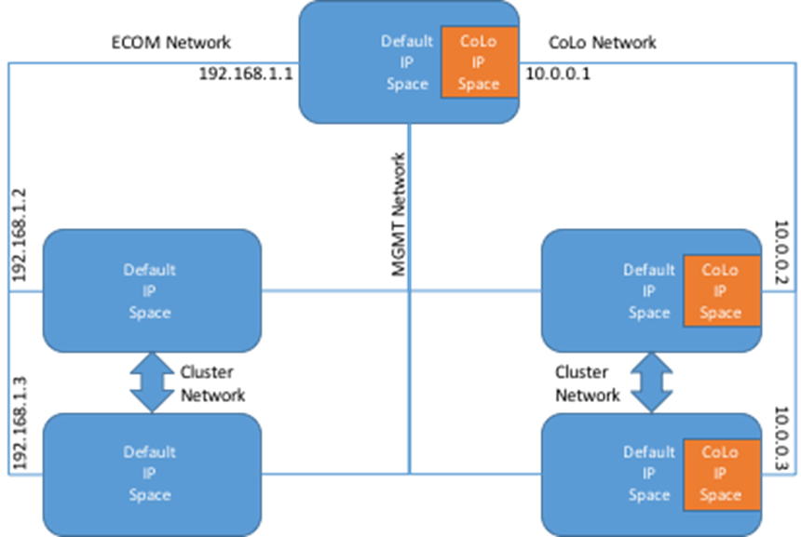
Network Configuration Example
The diagram shows how Dual Homing might be accomplished using IP Spaces.
A second IP Space is added (Orange On Diagram) and all communications are completely separate to the Default IP Space.

Slide 12
Root-Data Partitioning
For entry-level and All Flash FAS (AFF) platform models, aggregates can be composed of parts of a drive rather than the entire drive.
Root-data partitioning is usually enabled and configured by the factory.
When a node has been configured to use root-data partitioning, partitioned disks have two partitions.
The smaller partition is used to compose the root aggregate. The larger partition is used in data aggregates. The size of the partitions is set by Data ONTAP, and depends on the number of disks used to compose the root aggregate when the system is initialized. (The more disks used to compose the root aggregate, the smaller the root partition.). The partitions are used by RAID in the same manner as physical disks are; all of the same requirements apply.

Slide 13
Management Infrastructure
With AFF8080 and the introduction of cDOT 8.3.x we need updated OCUM and OPM servers. Work is already underway to provide these by upgrading the 6.3 and 2.0 systems already in place.
WFA is also being upgraded to 4.x in order to enable compatibility with the new management infrastructure.
There is a continued push towards automation of storage tasks and that is already addressing the differences in cDOT 8.3.x

Slide 14
Data Protection
AFF8080 will backup using SnapVault (XDP) to current destination systems.
Additional peer relationships available using IP Spaces
No changes with regard to
Cluster peer requirement
Vserver peer requirement

Slide 15
Additional Resources
TR Specific Docs
Storage Wiki
General cDOT/AFF8080 Information
Netapp Now Site
Netapp SharePoint Site
Colleagues
D&E

